Slide 1







MUSIC STORE ANALYSIS USING MYSQL

Slide 2




HELLO
My name is Pooja Gupta and in this project i have utilize sql queries to solve the question which are related to music store

Slide 3

Project Purpose:
The primary purpose of this project is to perform a comprehensive analysis of a music store's database to gain valuable insights into various business metrics and customer behaviors. Utilizing SQL queries, this analysis aims to identify key trends and patterns across multiple dimensions, including employee hierarchy, customer demographics, sales performance, and popular music genres. By leveraging the data from eleven interconnected tables, we can make data-driven decisions to enhance marketing strategies, optimize inventory, and improve overall business performance.
The project focuses on answering specific business questions that can lead to actionable insights, such as identifying top customers, understanding genre preferences by country, and recognizing high-performing employees

Slide 4


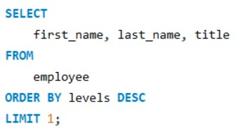
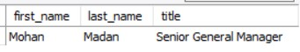

Senior Most Employee
Query
Output

Slide 5


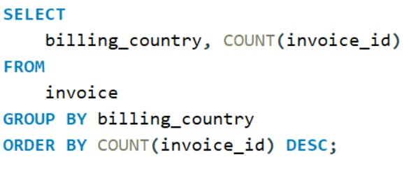
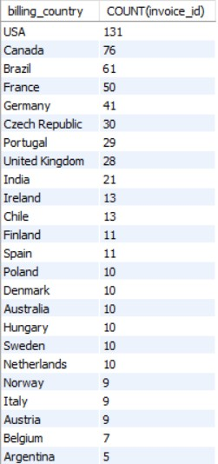
Invoice Distribution by Country
Query Output

Slide 6


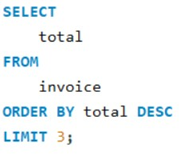
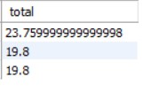


Top Invoice Values
Query
Output

Slide 7



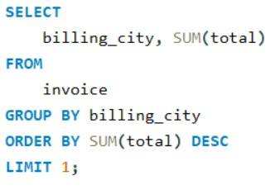
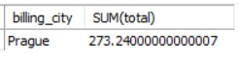
Best Customer City
Query
Output

Slide 8

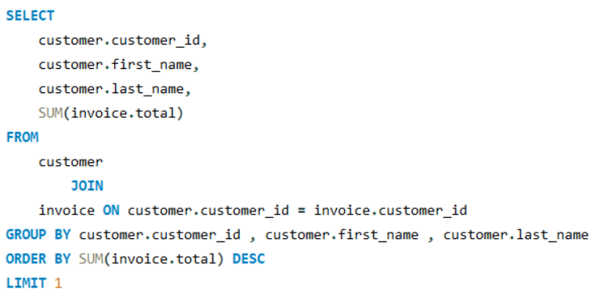


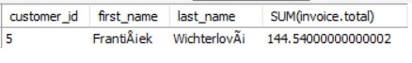
Top Spending Customer
Query
Output

Slide 9

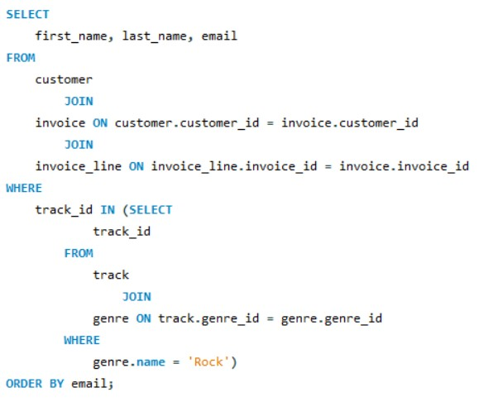

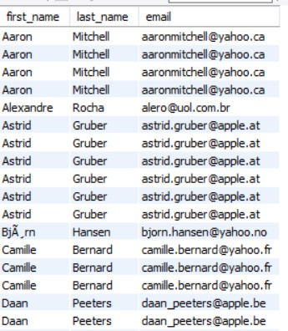
Rock Music Listeners
Query
Output

Slide 10

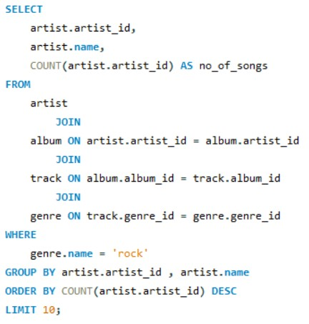
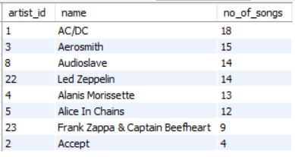


Top Rock Artists
Query
Output

Slide 11


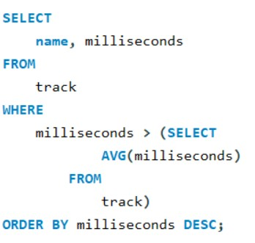
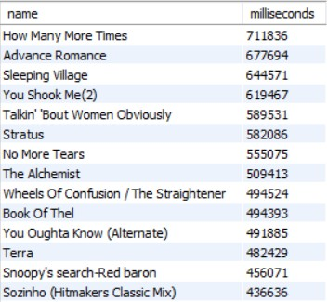

Tracks Longer Than Average
Query
Output

Slide 12
Customer Spending on Artists
Query
CTE =

Slide 13

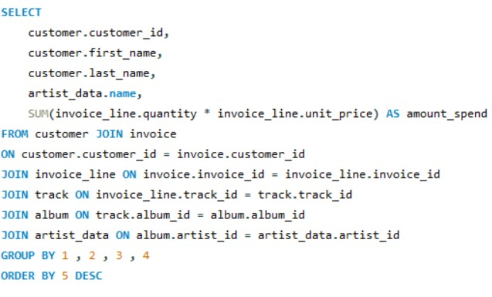
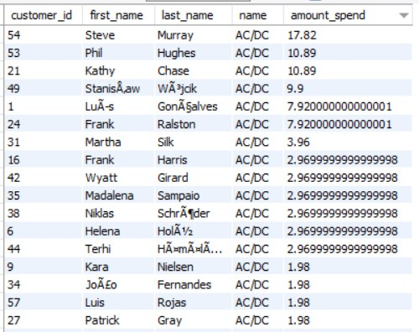



Main Query
Output

Slide 14


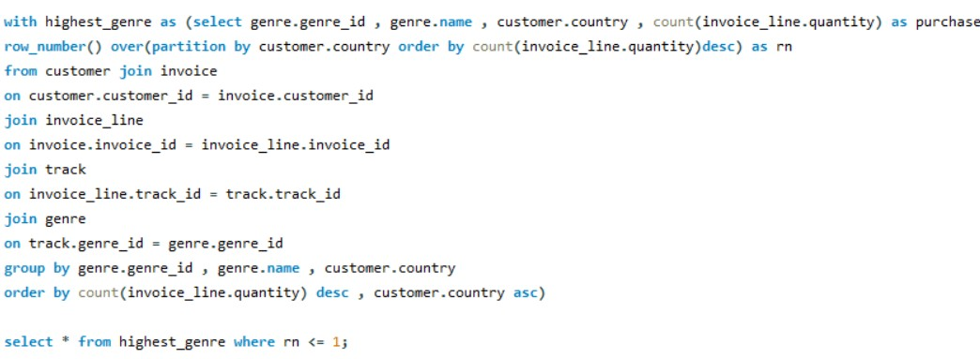
Popular Music Genre by Country
Query

Slide 15


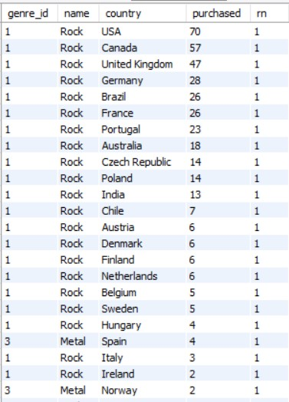



Output

Slide 16

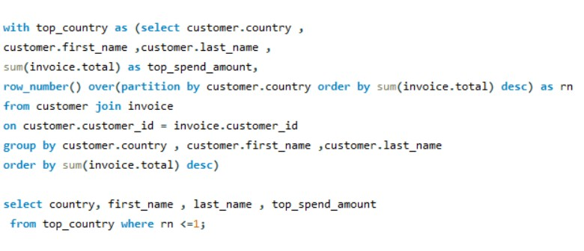
Top Customer by Country
Query

Slide 17

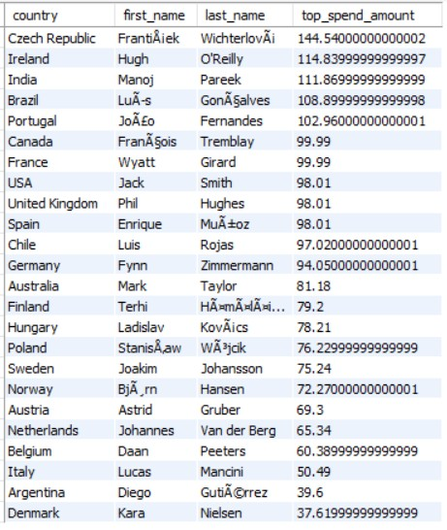

Output

Slide 18
Conclusion
We identified that the most senior employee based on job title is Mohan Madan, who is a Senior General Manager. The USA was highlighted as the country with the most invoices, where the majority of our sales occur.
The top three invoice values are 23.75, 19.8, and 19.8, giving us an understanding of the highest revenue- generating transactions.
Prague was identified as the city where our most valuable customers reside, with the highest sum of invoice totals being 273.24.
František Wichterlová has spent the most, highlighting potential opportunities for loyalty programs, with a total spending of 144.54.
We extracted a list of customers who listen to rock music, enabling targeted marketing for rock music promotions. We identified the top 10 rock artists by track count, helping us understand popular music preferences and potential artist collaborations.
By listing tracks longer than the average song length, we can better understand customer preferences for track duration.
We analyzed customer spending on the best-selling artists, providing insights into which artists drive the most revenue.
The most popular music genre in each country was determined, enabling country-specific marketing strategies. Finally, we identified the top-spending customers in each country, providing opportunities for targeted high-value customer engagement.
Overall, this project has equipped us with a deeper understanding of our customer base, sales trends, and market opportunities, paving the way for strategic business growth.

Slide 19

Thankyou

